Slide 1
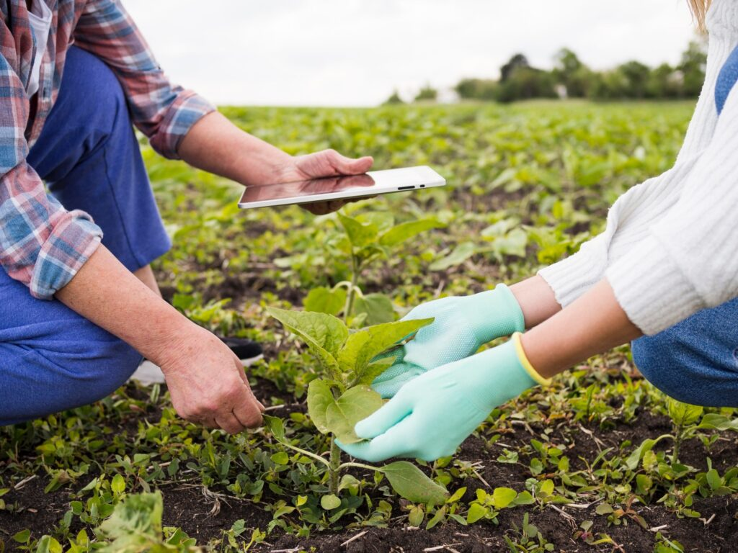
Why Partner with Us
Cultivating Success Together—from Soil to Shelf

Slide 2
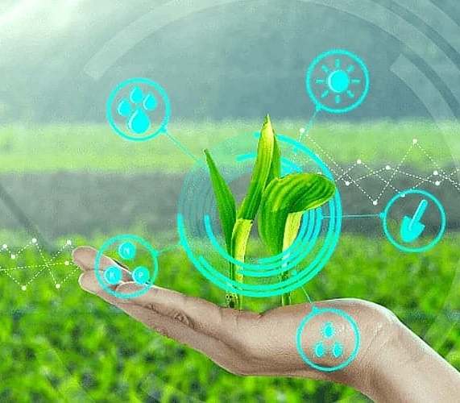
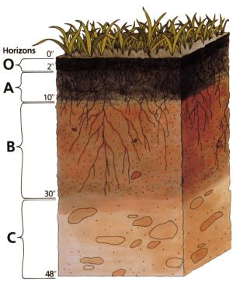
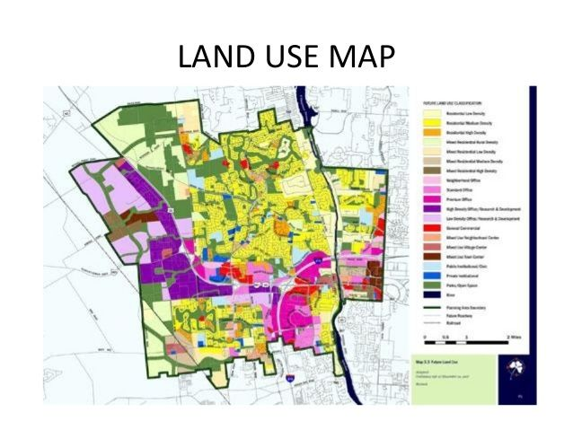
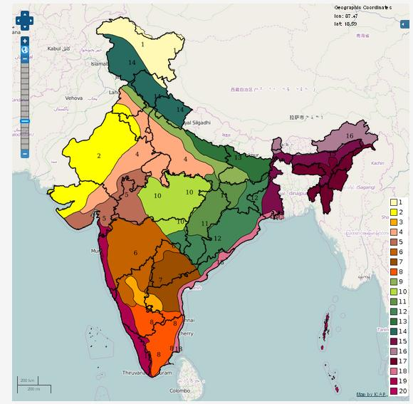
Our Services
Geographical Analysis
Agri-Climatic Zone Mapping
Soil Profile Analysis
Water Resource Assessment
Crop Suitability Assessment
GIS-Based Land Use Mapping
Market Accessibility Mapping
Climatic Risk & Mitigation Strategy
Geographical Analysis

Slide 3
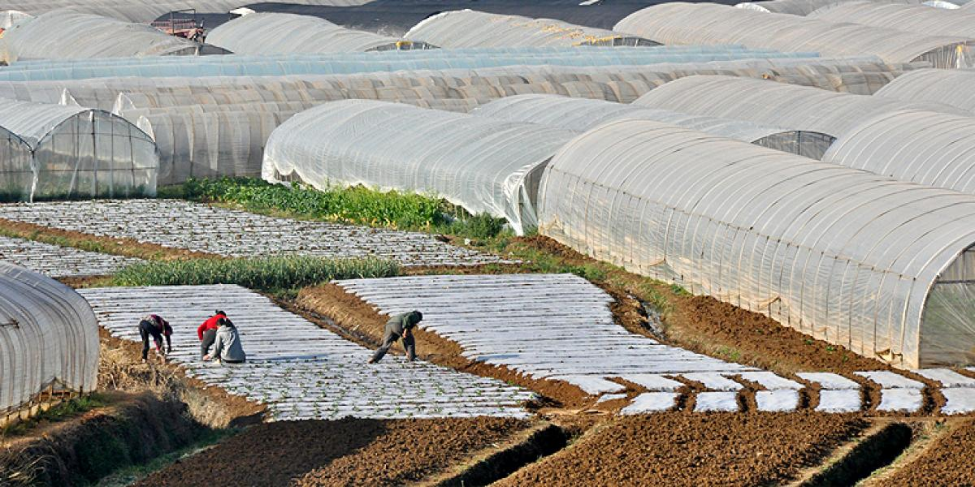
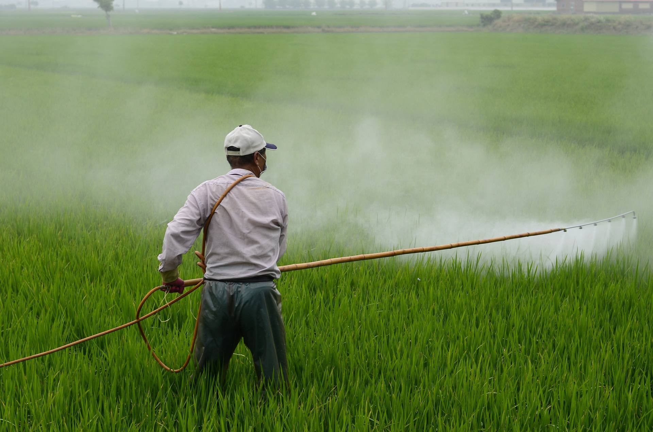

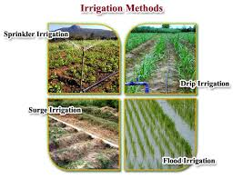
Our Services
Crop Cultivation Assistance
Crop Selection & Planning
Land Preparation Guidelines
Seed Procurement & Nursery Support
Agronomy & Package of Practices
Pest & Disease Management
Irrigation & Water Management
Harvesting & Post-Harvest Advisory
Training & handholding

Slide 4

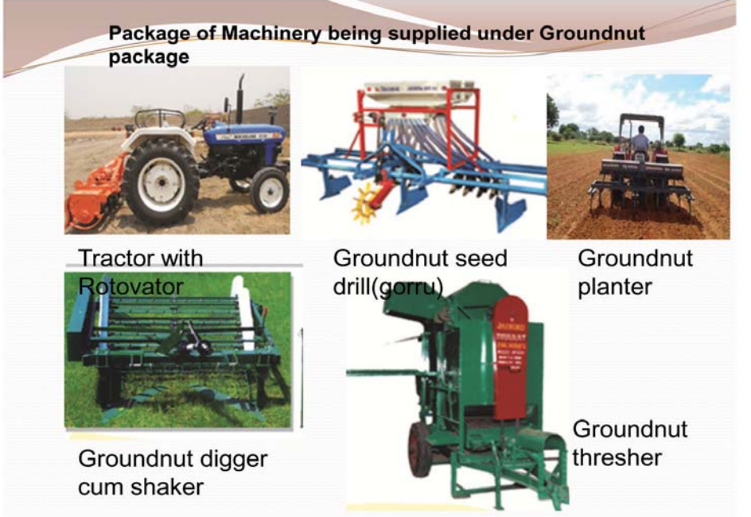
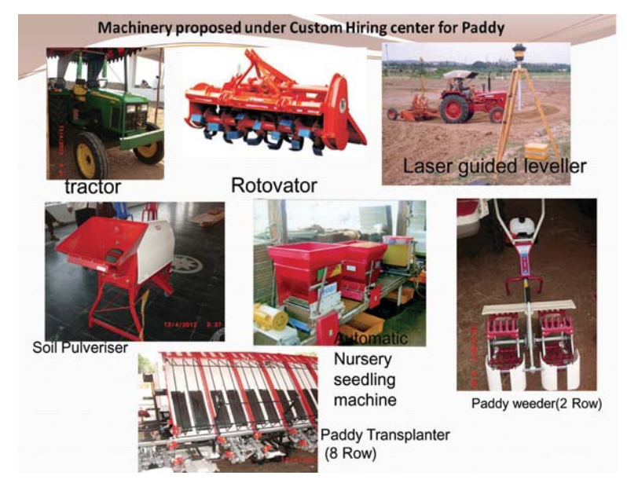
Our Services
Advanced Machines & Equipment's
Mechanization Needs Assessment
Machinery Planning & Specification Finalization
Manufacturer Identification & Quotation Collection
Techno-Commercial Evaluation
Demonstration & Training
Maintenance & Support

Slide 5
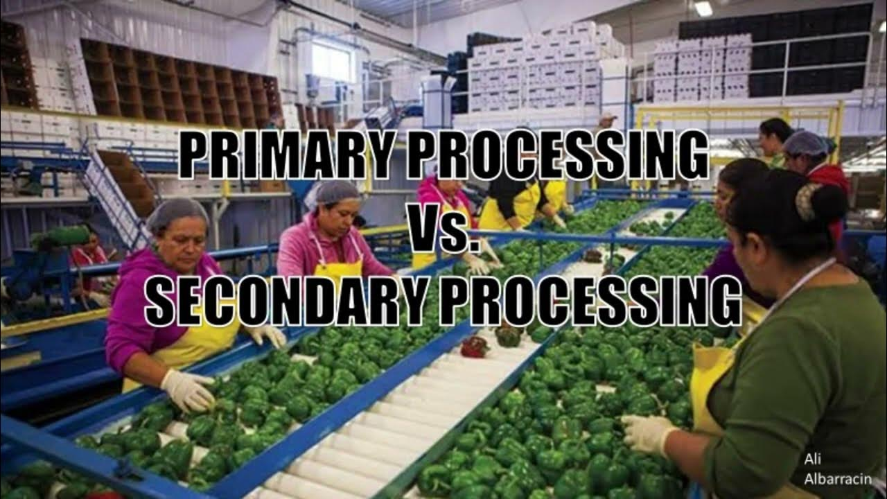
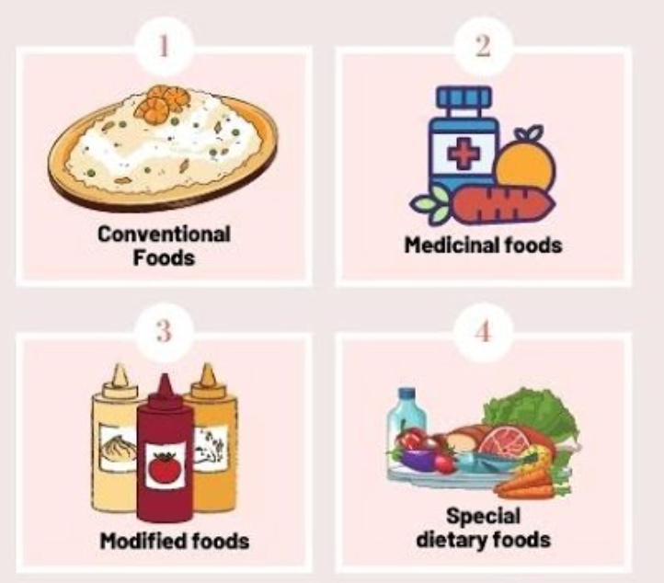
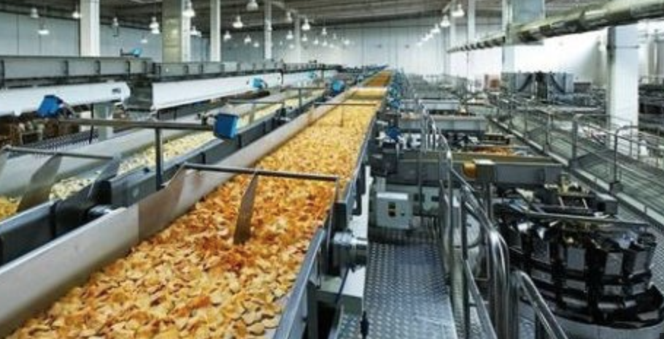

Our Services
Agri Value Additions
Post-Harvest Handling
Cleaning, grading, and sorting of raw produce
Cold storage and logistics planning
Primary Processing
Drying (solar, tunnel, freeze-drying)
Milling, pulping, juicing, oil extraction
Dehydration, roasting, and fermentation
Advanced Processing & Formulation
Preparation of ready-to-eat or ready-to-cook products
Product Development & Innovation
R&D for new food formulations (organic, fortified, Sensory testing and recipe standardization
Quality & Safety Compliance
FSSAI, HACCP, ISO certification support
Lab testing (microbial, pesticide residue, nutritional profiling)
Traceability systems and packaging compliance

Slide 6

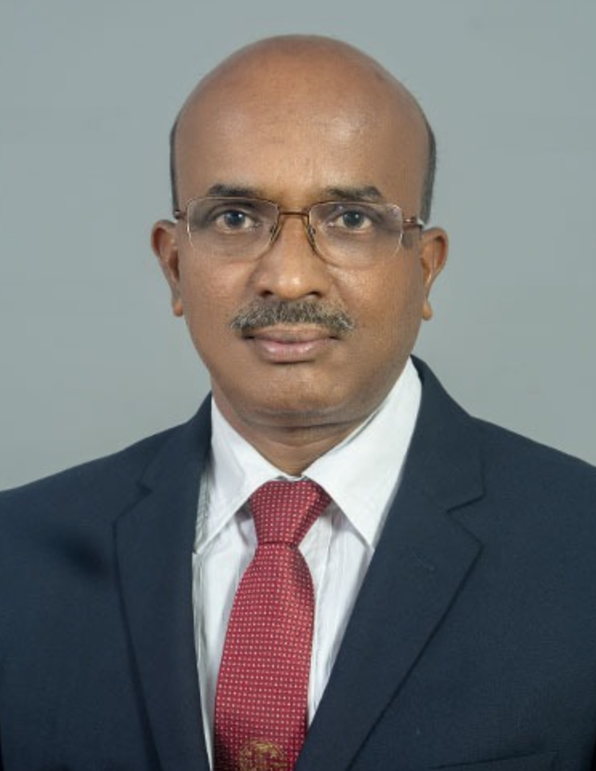
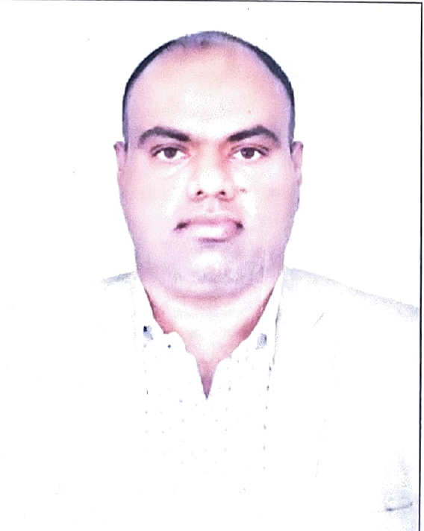
Our Core Team Members
Dr. Shankar – Senior Agriculture Advisor (Rtd. Vice Chancellor from Horticulture University)
Experience: 35+ Years | Domain Expertise: Crop Cultivation, Large-Scale Farm Management, Agri Execution Strategy
Mr. Shankar is a seasoned agricultural expert with over three decades of hands-on experience in planning, managing, and executing cultivation across diverse agro-climatic zones. With a deep-rooted understanding of traditional and modern farming practices, he has successfully led and supervised cultivation across 2000+ acres, spanning a wide variety of crops including fruits, vegetables, cereals, pulses, oilseeds, horticultural, and medicinal plants.
His core strengths lie in:
Designing location-specific crop cycles and farm layouts
Managing end-to-end farm operations including land preparation, sowing, pest control, irrigation, and harvesting
Introducing sustainable practices such as integrated nutrient management, organic farming, and drip irrigation
Mentoring field teams, training farmers, and ensuring quality compliance in all stages of cultivation
Coordinating with government bodies and agri-institutions for field trials and adoption of new technologies
Mr. Sivakumar – Chief Technical Manager
Expertise: Agricultural Projects | Value-Added Agri Products | Process Design & Quality Systems
Mr. Sivakumar serves as the Chief Technical Manager, bringing over 18 years of experience in managing large-scale agricultural initiatives and the development of value-added agri products. He leads the technical vertical across all stages of the agri value chain—from cultivation planning to post-harvest processing and commercialization.
Key areas of expertise:
Designing and implementing integrated crop production systems aligned with market demand
Leading technical feasibility studies and preparing DPRs for processing units (e.g., cold storage, peanut butter, spice grinding, fruit pulping, etc.)
Standardizing process flow for value-added product manufacturing with a focus on shelf-life, food safety, and cost-efficiency
Driving technology selection, plant layout planning, equipment finalization, and trial batches for new products
Ensuring regulatory compliance (FSSAI, AGMARK, Organic Certification) and guiding clients through licensing & approvals
Training teams and operators on SOPs, HACCP implementation, and Good Manufacturing Practices (GMP)

Slide 7
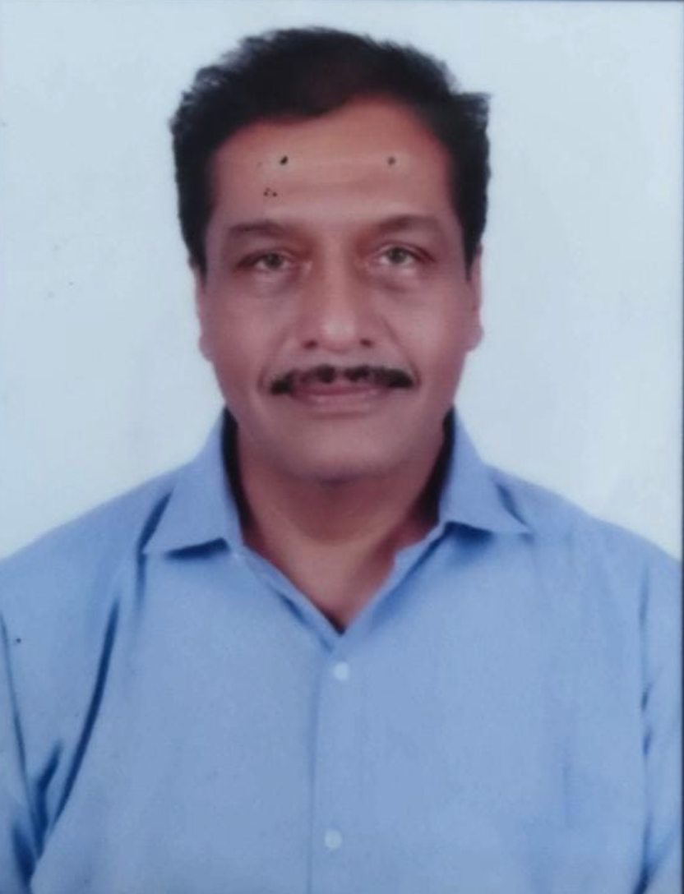
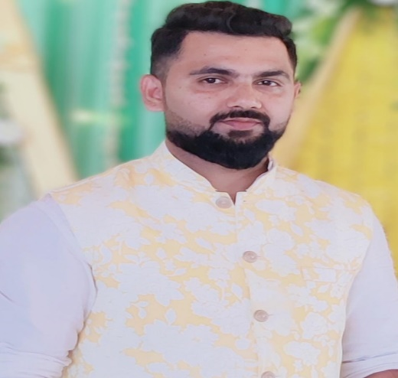
Our Core Team Members
Mr. Nithin – Senior Project Management Specialist
Expertise: Agri Project Execution | Value-Added Product Development | Soil-to-Silk Implementation | India & Middle East
Mr. Nithin is a highly accomplished Senior Project Management Specialist with rich experience in driving end-to-end execution of agriculture-based and value-added product ventures across India and the Middle East. With a deep understanding of integrated farming models, food processing systems, and international deployment strategies, he has successfully led high-impact agri-industrial projects in diverse agro-climatic conditions.
Key Areas of Expertise:
Comprehensive project planning & management for agriculture and agro-processing initiatives
Proven track record in implementing “Soil-to-Silk” projects, including mulberry cultivation, silkworm rearing, silk yarn processing, and silk fabric finishing in arid regions of the Middle East
Extensive experience in value-added agri product development such as peanut butter, spice powders, cold-pressed oils, and fruit-based products
On-ground coordination with machinery suppliers, EPC contractors, farmers, and skill development teams
Cost optimization, milestone tracking, quality assurance, and regulatory compliance (FSSAI, export norms, etc.)
Familiarity with government schemes, PPP models, and subsidy-based funding frameworks
Dr. S A Hipparagi : Rtd. Scientist with 35+ Years of Experience in Silk Industry(Central Silk Board of India)
Key Expertise
Successfully Executed Design Directory Project Assigned By The Government Of Madhya Pradesh
Worked As A Team Member For Creation Of The Printing Cluster In Srirampura Cluster Of West Bengal
Worked For Creation Of Product Development design And Diversification Centre At Central Silk Board Bangalore For One Decade
Worked As A Master Trainer In Design Development At Kigali Capital Of Rwanda In African Zone
Worked For Project Of ERI CARPET CREATION OF DC Handlooms Government Of India Work As A Handloom
Presently Working On Cosmetic Laboratory Application Of Sirising For Different Cosmetic Products
Worked For Creation Of Natural Died And Printed Silk Products In Different Clusters Of India Like Bagh Madhya Pradesh Neemuch Madhya Pradesh Sanganer Rajasthan Kalamkari Andhra Pradesh
Specialization Is In Silk Printing With Natural Dies And Extraction Of A Cosmetic Application And Silk Finishing
Certifications, Awards & Memberships
ISO/IEC-17025:1999(E) – Quality Management Systems
  Winner of "TexQuest 2007"
  Life Member of Textile Association of India
  Life Member of National Academy Sericulture Sciences, India
  Board of Studies, Member of Silk technology and Textile technology for VTU, Belgaum, Karnataka
  Designing and Fabrication of CSTRI Eco-de-gumming Machine
  India Patent I.P.R/F.A/13017/2013 Issued 2013 (This machine is most suitable for de-gumming of silk and uses no chemicals. Saves electricity, water and Labor)

Slide 8
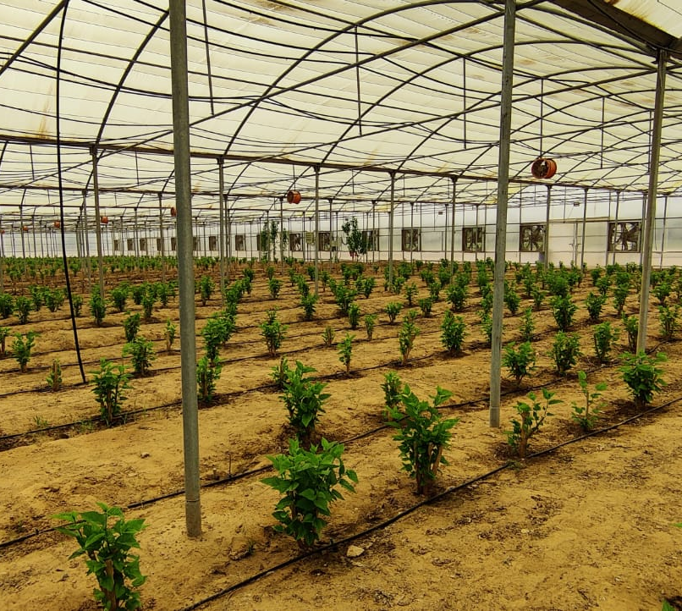
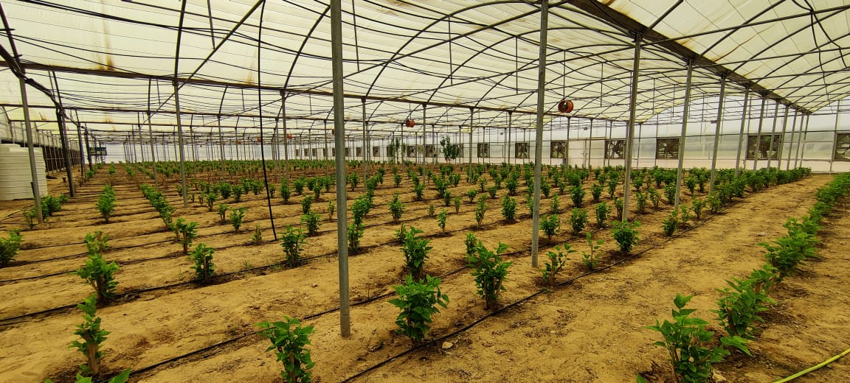
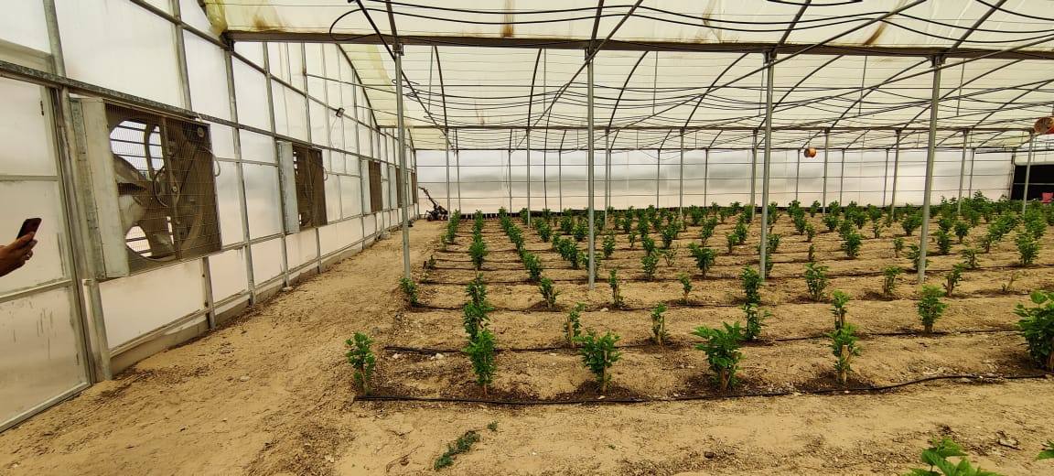
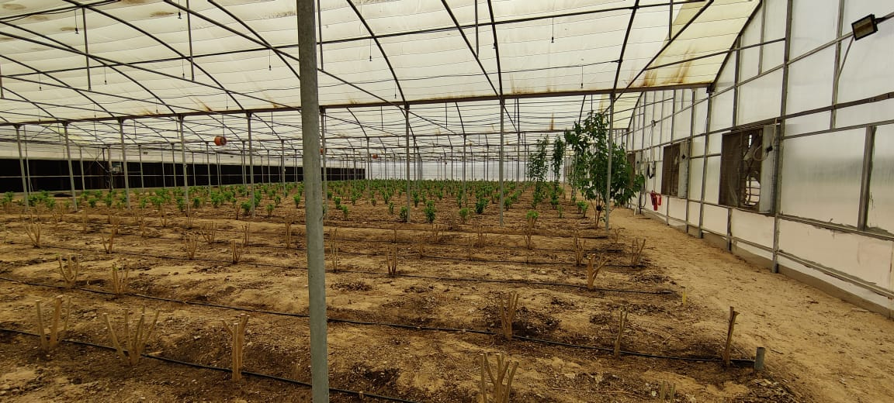
Key Projects Executed
- Mulberry Plantation at UAE

Slide 9
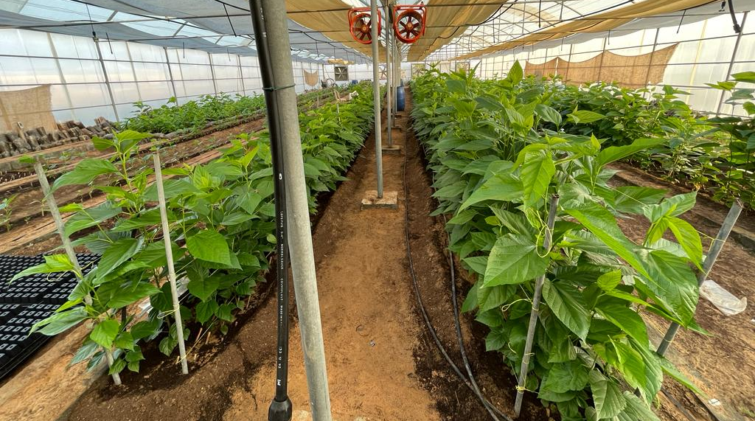
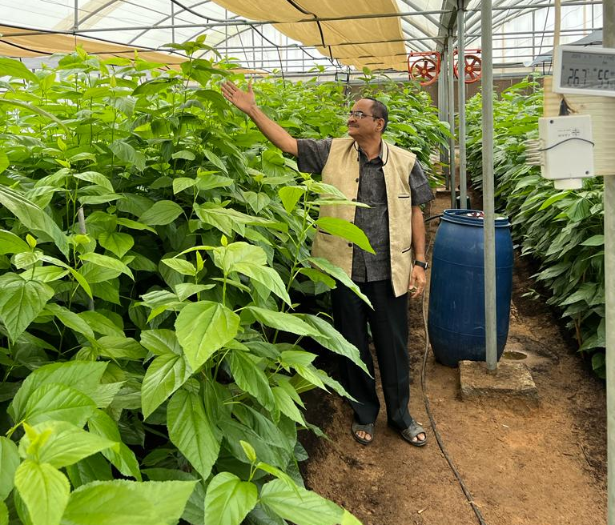
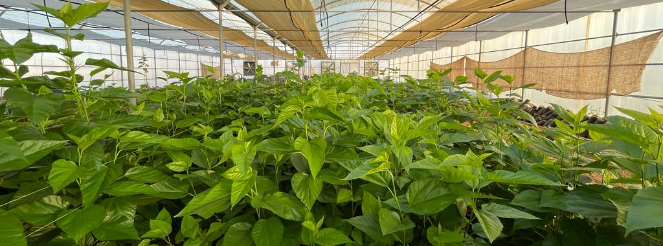
Key Projects Executed
- 500 Hectares for Soil to Silk at Abu Dhabi, UAE

Slide 10
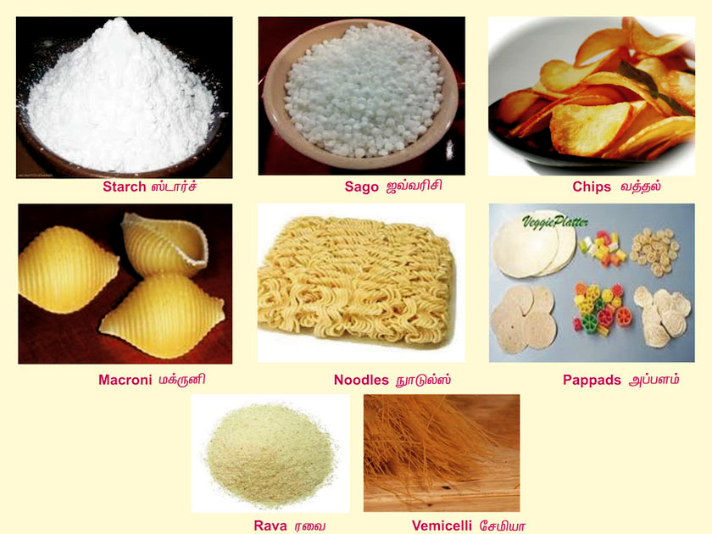
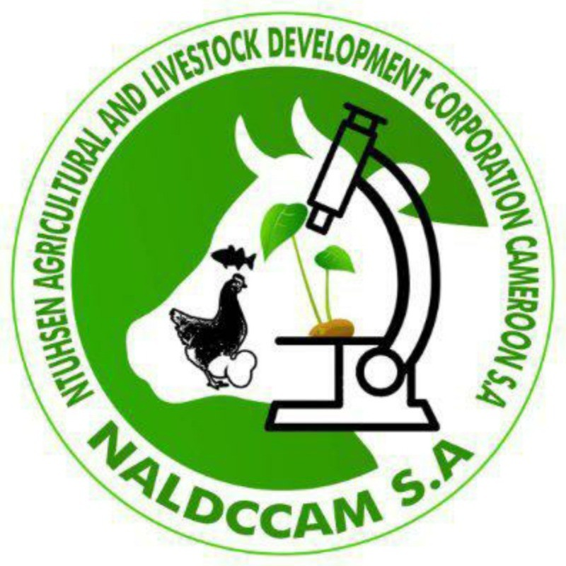

Key Projects Executed
Damas Yaoundé, Cameroon
1. Cassava production: Establishment of 5000 hectares of cassava farms, utilizing modern farming techniques to increase productivity and efficiency.
2. Processing and manufacturing: Construction of a state-of-the-art cassava processing plant, capable of producing a wide range of cassava by-products, e.g. cassava flour, starch, and ethanol.

Slide 11

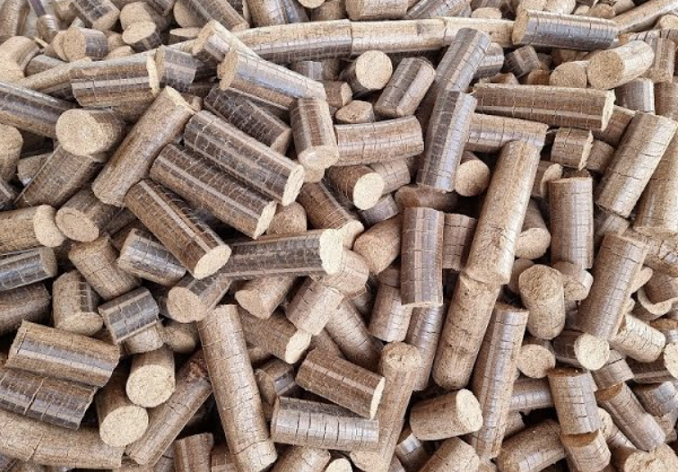
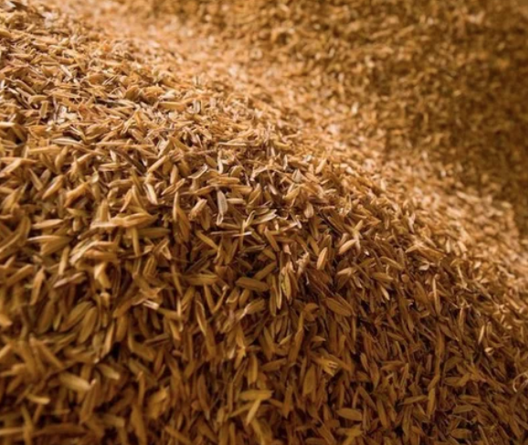
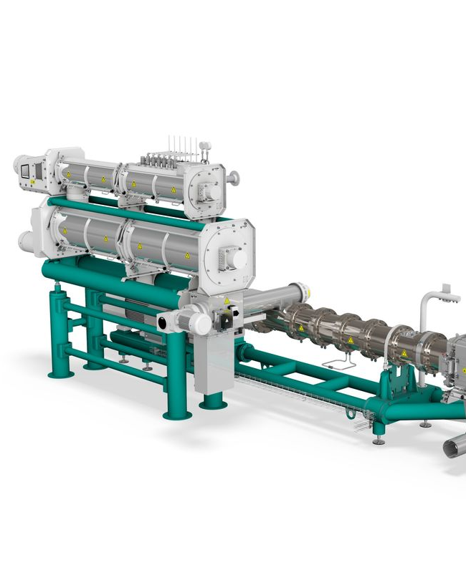
Kano, Nigeria - Stallion Group
Broken Rice to Whole Rice using Buhler Extrusion Technology
Rice Husk to Briquette

Slide 12
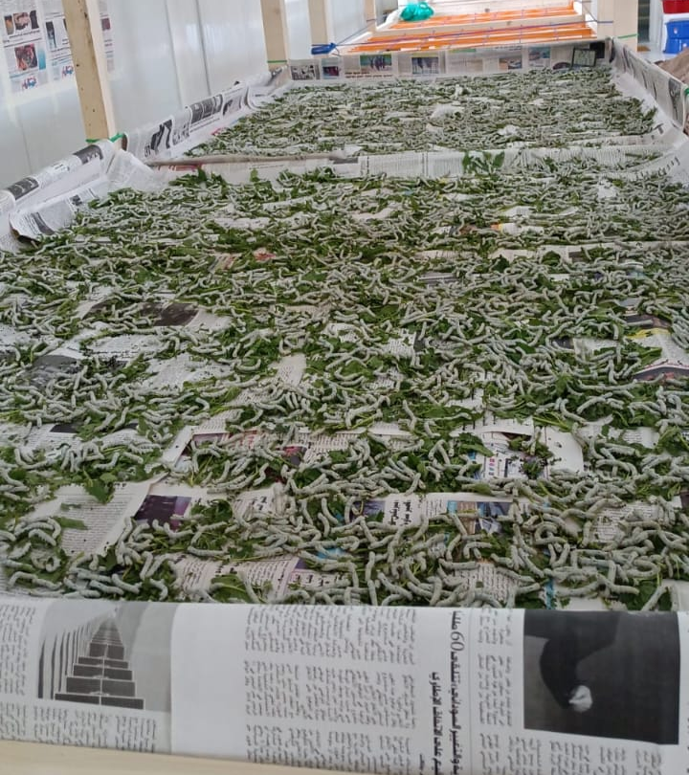
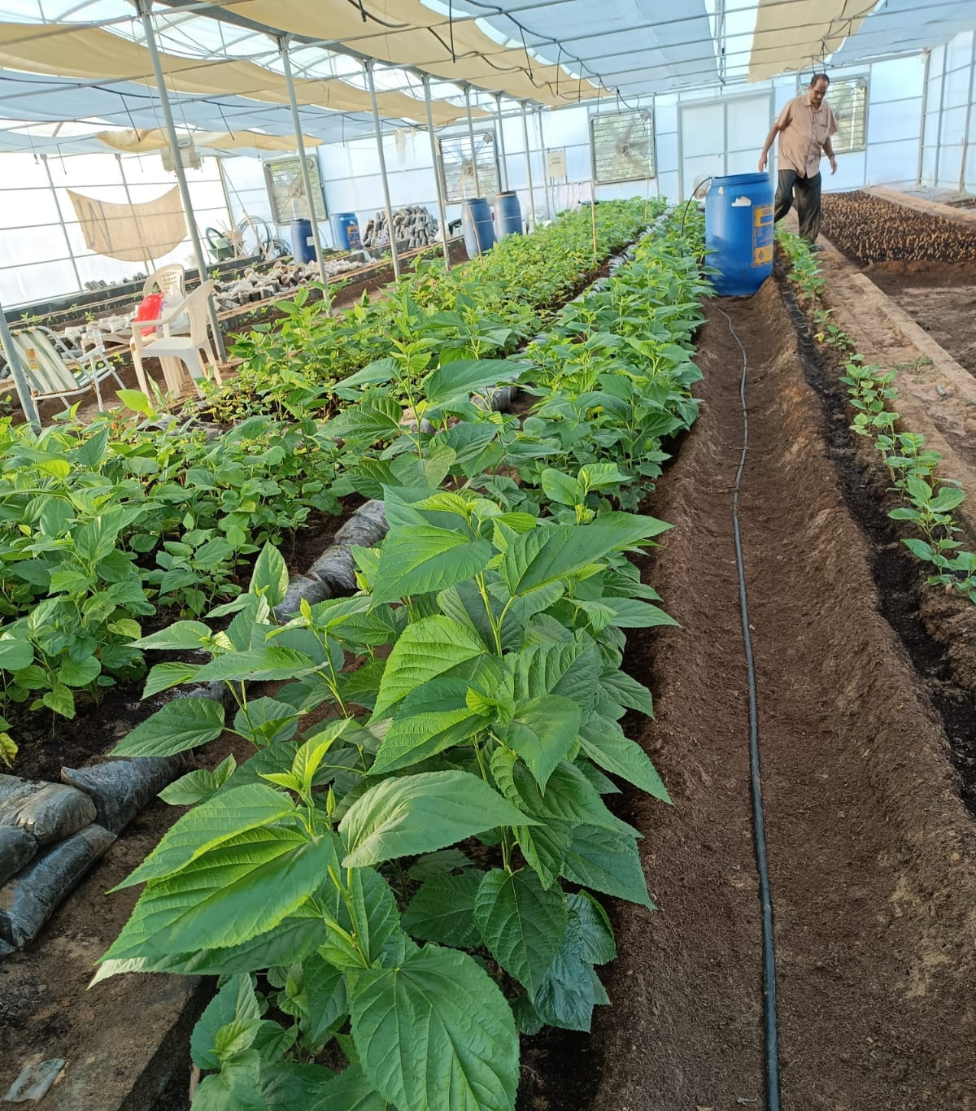
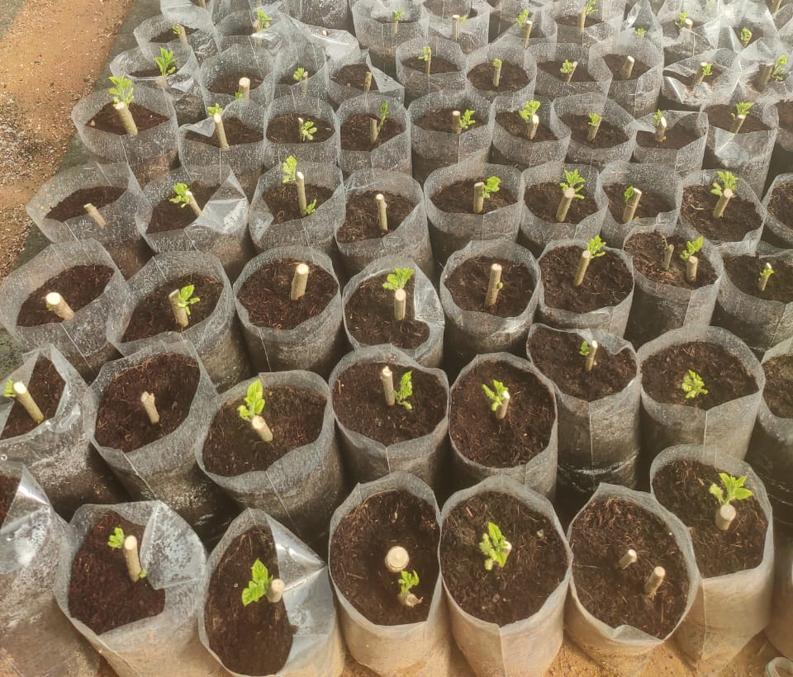
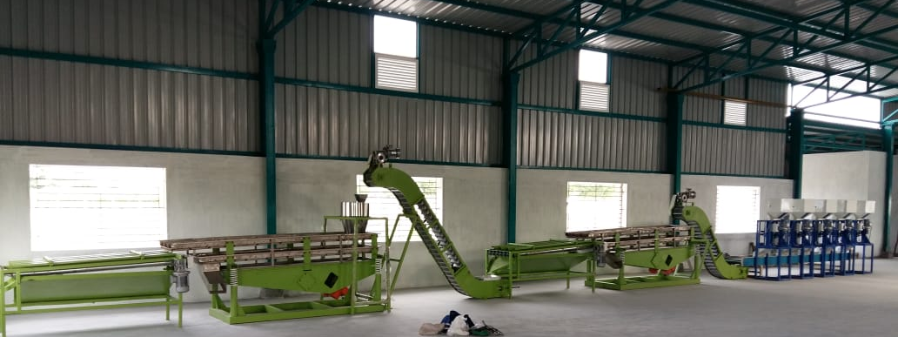
Key Projects Executed
- Nursery to Commercial Value Addition of Mulberry with Fruits & Silk

Slide 13
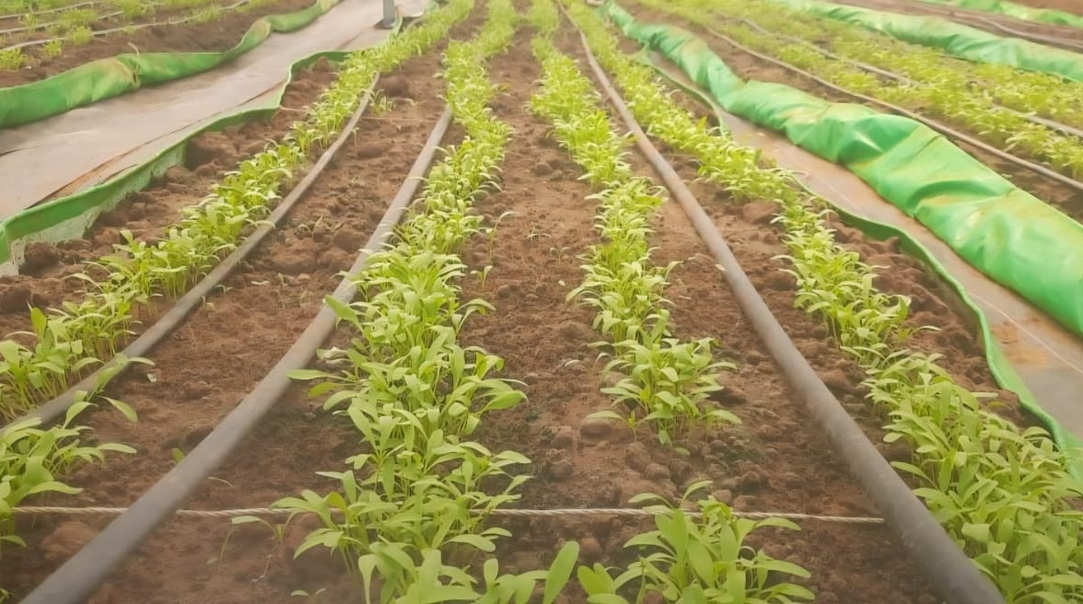
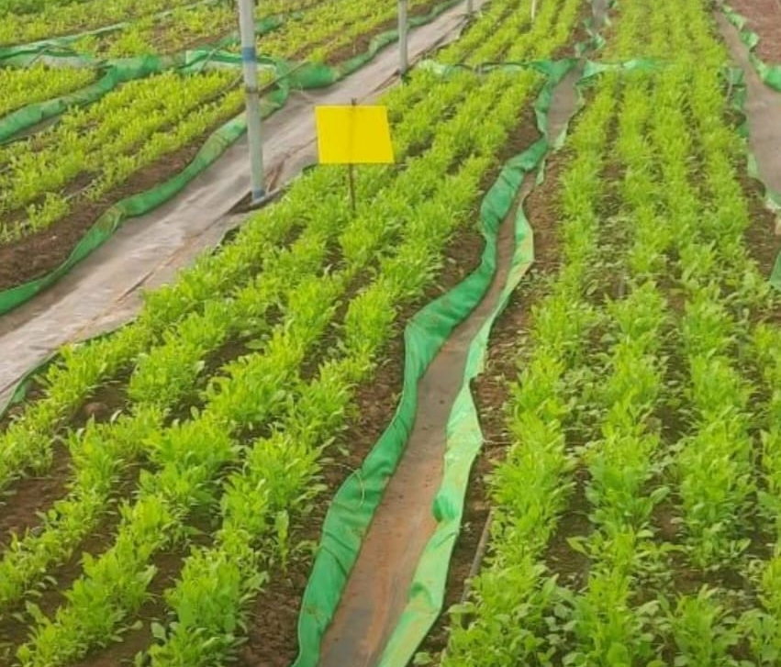
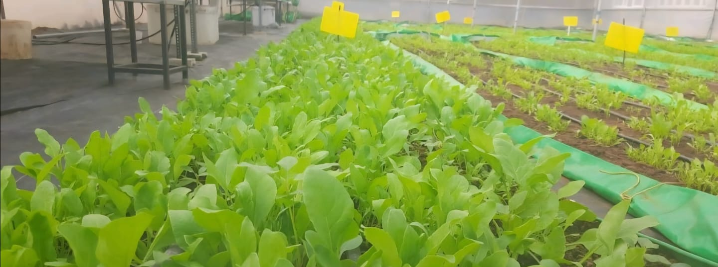
Key Projects Executed
- 700 Acres at Ooty India for Spinach

Slide 14
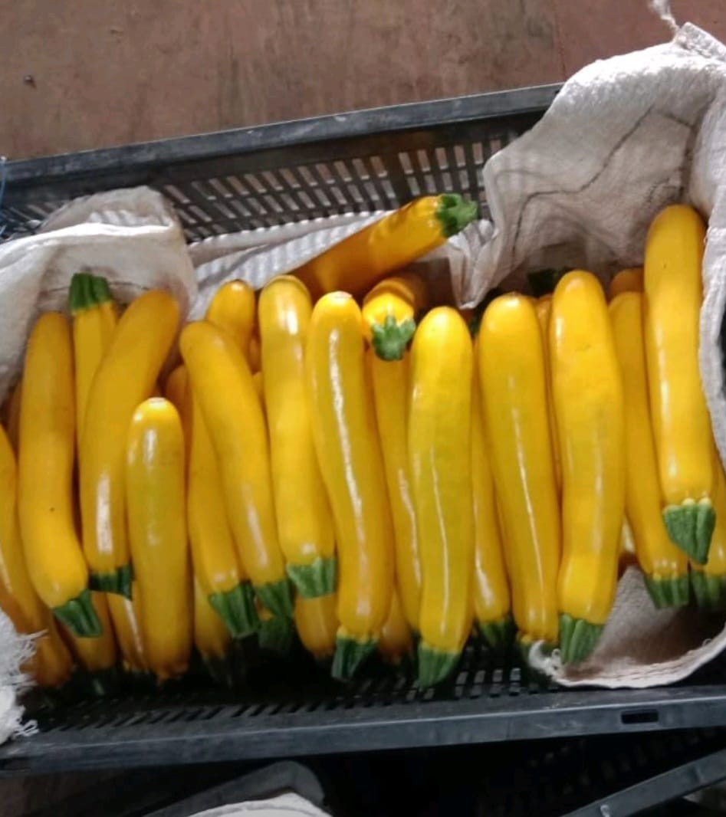
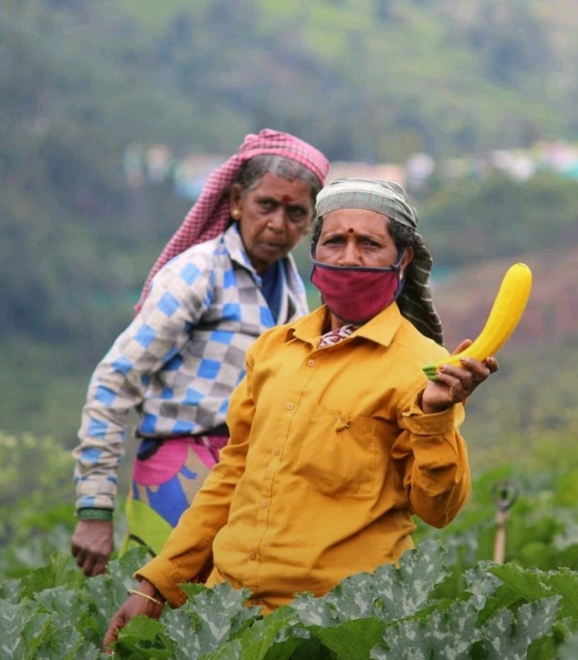
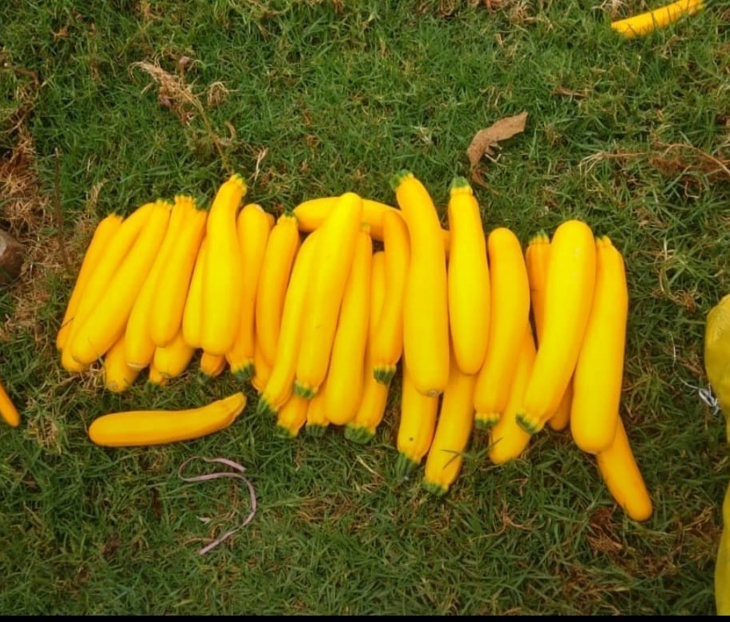
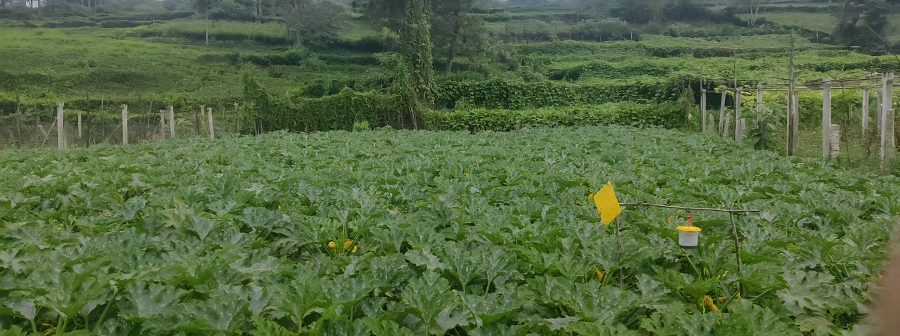
Key Projects Executed
- 950 Acres of Cultivation

Slide 15
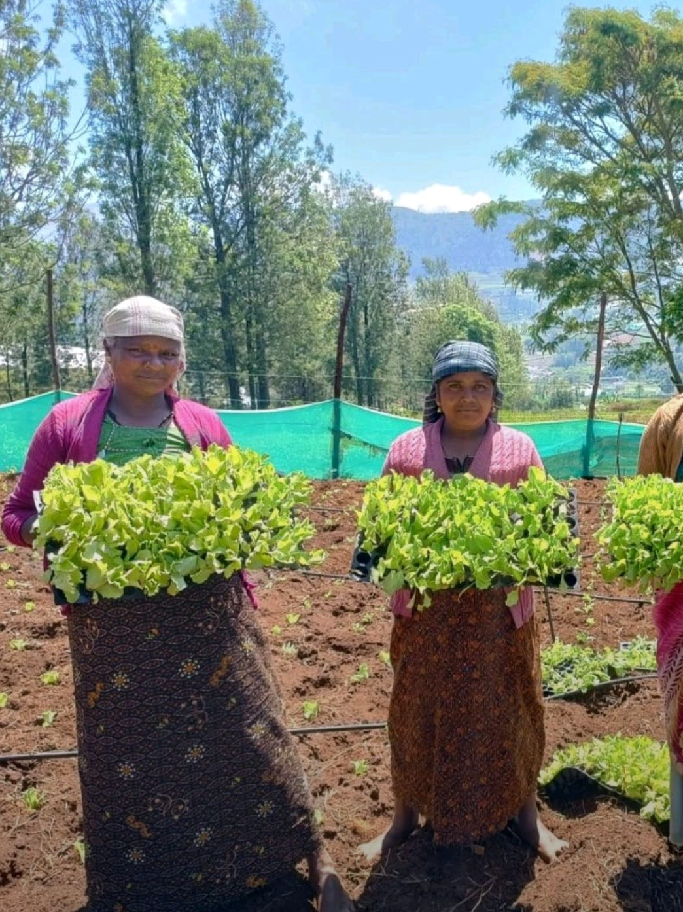
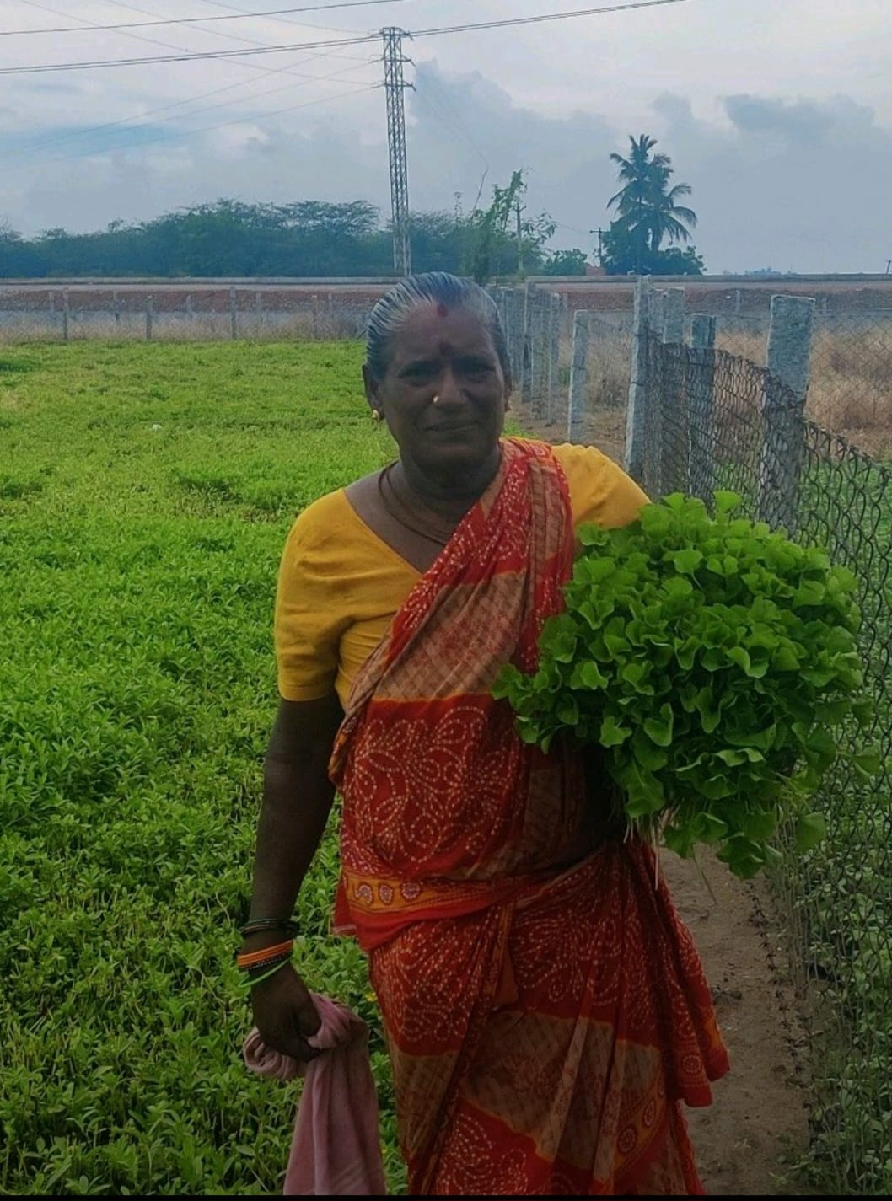
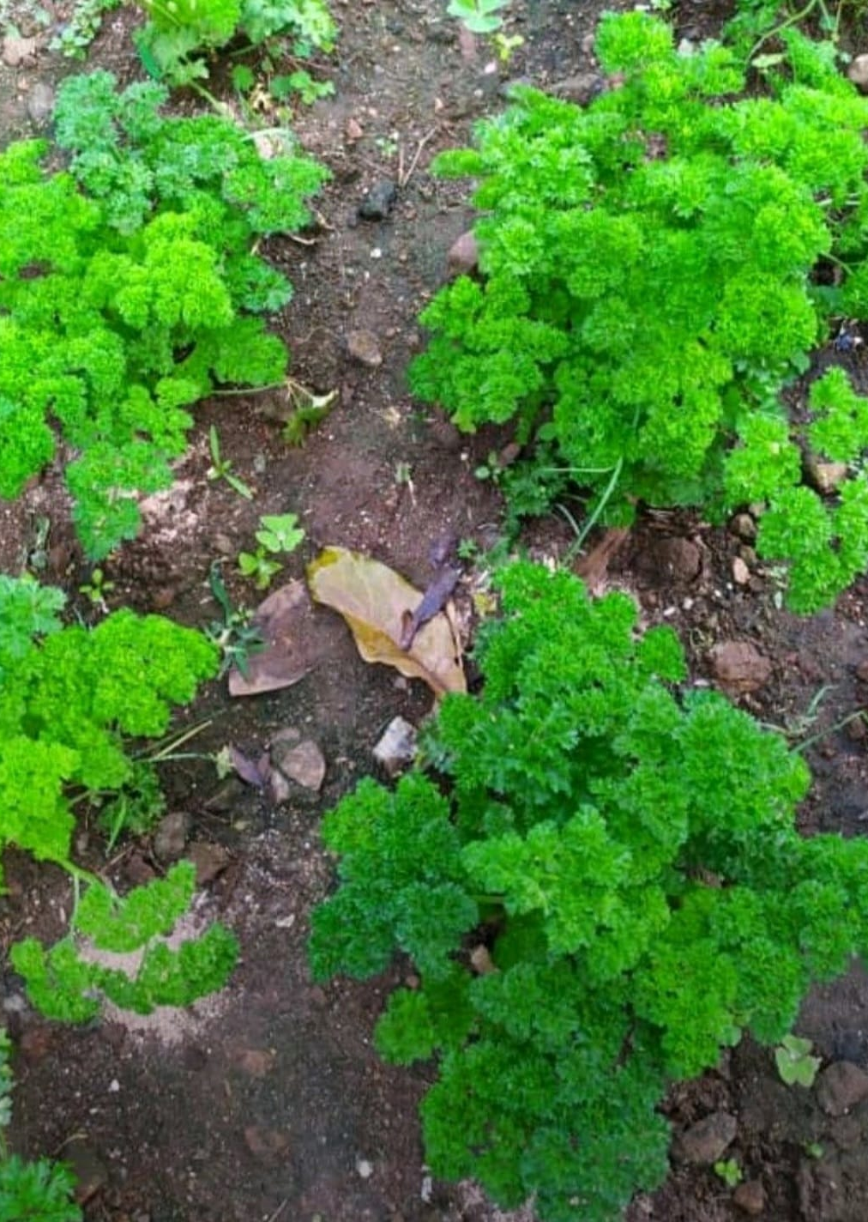
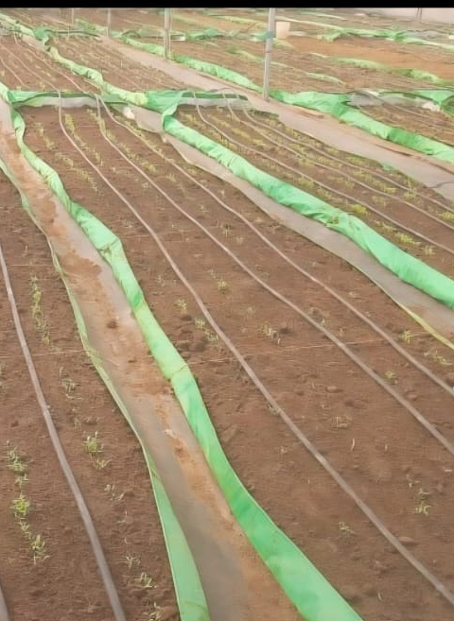

Key Projects Executed
- 500+ Acres for Broccoli and Lettuce

Slide 16
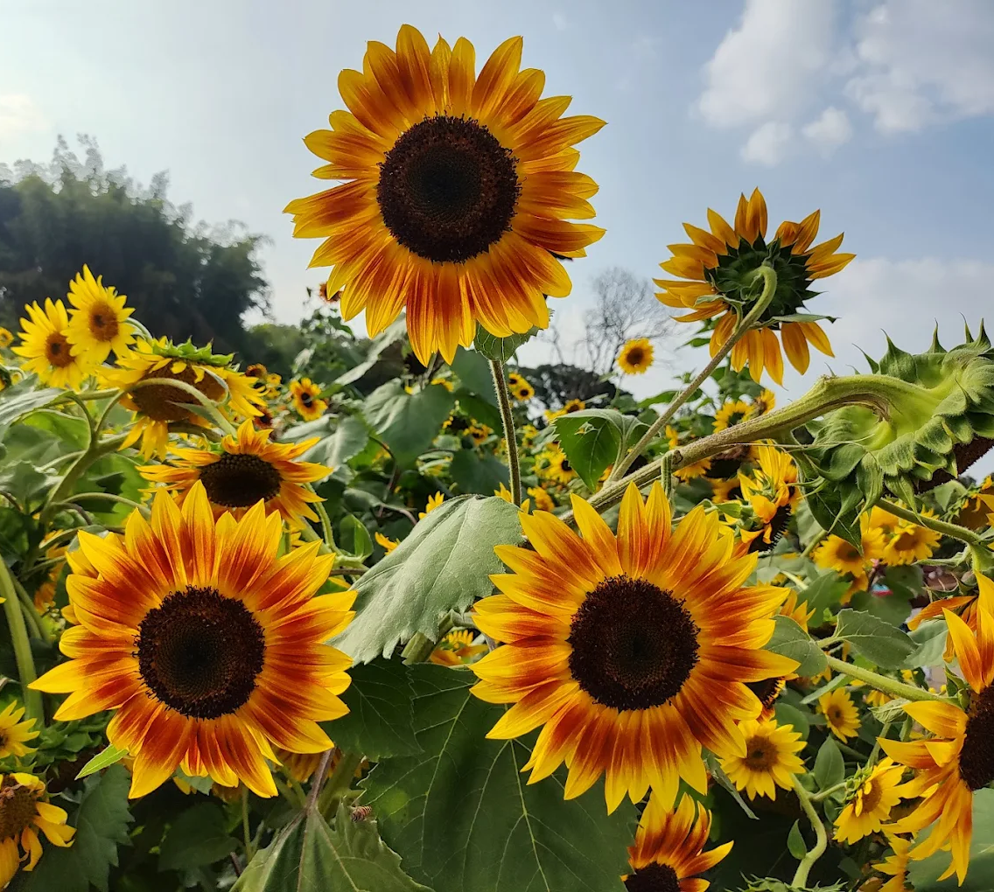
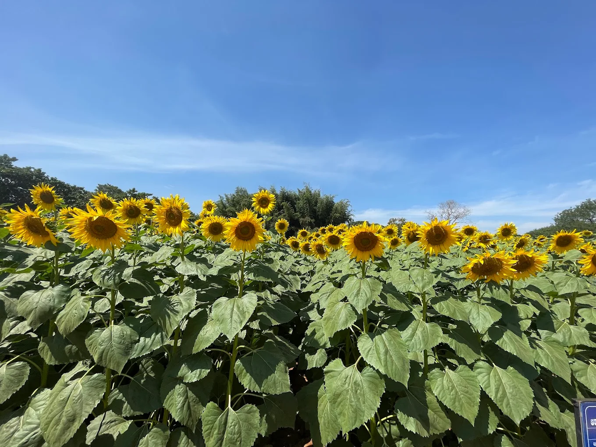
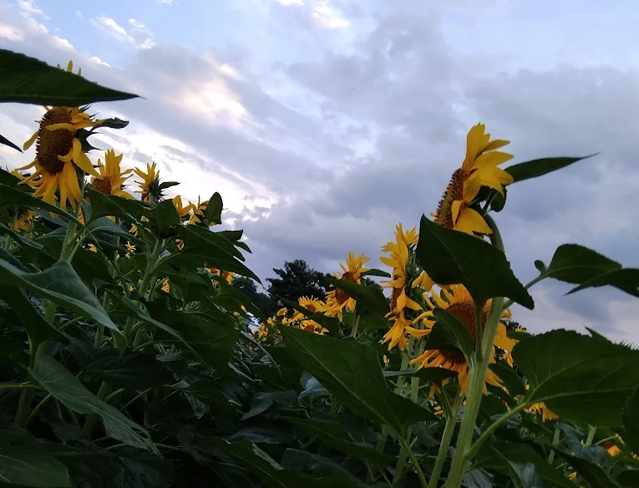
Key Projects Executed
1000 Acres Sunflower Project

Slide 17


Successful Projects
1. Cultivation of Damask Rose at Thali, Krishnagiri, Tamil Nadu
      We successfully executed the 200-acre Damask Rose cultivation project, ensuring optimal soil conditions, irrigation systems, and sustainable farming practices. Groundnut Cultivation – 800 Acres
2. Ginger Cultivation & Value Addition Project in Andhra Pradesh
  We led the 1000-acre Ginger cultivation project, implementing optimized soil health protocols, drip irrigation, and integrated pest management to ensure robust rhizome yields. Post-harvest, we established an on-site processing unit for value addition, producing premium ginger powder, essential oils, and dehydrated chips, meeting both domestic and export quality standards.
  3. Soil To Silk Project – Mulberry Plantation to Silk – Abu Dhabi 500 Acres
  With deep agronomic and sericulture expertise, we executed the Soil-to-Silk project, establishing optimized mulberry plantations and controlled silkworm rearing units to maximize cocoon yields. The initiative integrated advanced silk reeling and yarn‑spinning facilities, utilizing precision equipment and best practices in temperature and humidity management for consistent, high‑quality silk fiber.
  4. Turmeric Cultivation – Maharashtra
  We successfully executed a 50-acre Hydroponics Turmeric cultivation project, utilizing advanced NFT (Nutrient Film Technique) systems to optimize water and nutrient usage, ensuring healthy and consistent turmeric rhizome growth. By employing state-of-the-art climate control and automated irrigation systems, we achieved significantly higher yields, faster growth cycles, and minimal water usage compared to traditional soil-based methods.
  5. Sunflower Cultivation – Nanjangudu, Karnataka
  Successfully implemented sunflower cultivation across 1,000 acres, focusing on high-oil yielding varieties with precision agronomy practices. The harvest was efficiently processed into value-added products like cold-pressed oil, ensuring better returns for farmers and high-quality output for the market.

Slide 18
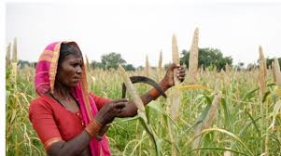
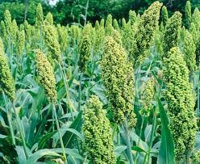
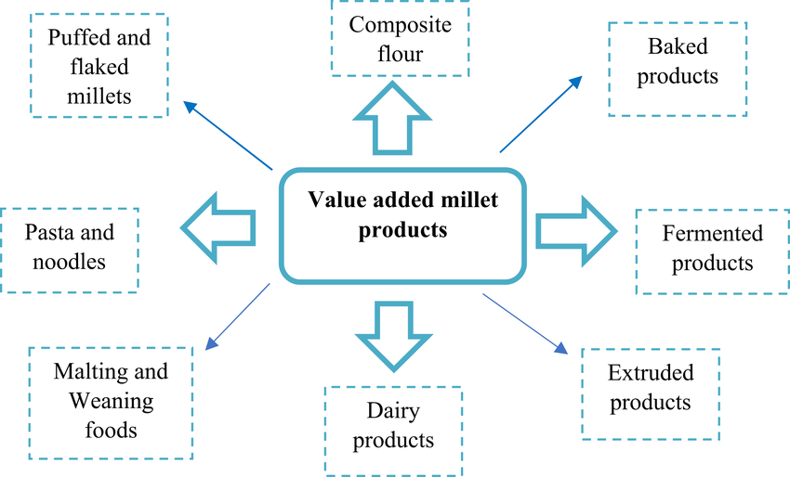
Turnkey Projects - Farm-Value Addition-Global Market
Millets & Pulses Cultivation and converting into Value Added Products – MID-DAY MEAL PROGRAM
Location: Guwahati, Assam, North-East part of India
In collaboration with the Government of Assam, we have initiated a comprehensive program focused on the cultivation of millets and pulses, leveraging the region’s agro-climatic strengths. This initiative promotes nutrient-dense, climate-resilient crops through sustainable farming practices and support for local farmers.
The harvested crops are processed into value-added, ready-to-consume nutritional products such as fortified millet-based porridges, protein-rich pulse mixes, energy bars, and instant meal options. These products are specially formulated to address malnutrition among children, and to meet the dietary needs of pregnant women and lactating mothers.
By combining agriculture, food processing, and public nutrition, the project not only ensures improved health outcomes for vulnerable populations but also creates livelihood opportunities for local farming communities and promotes regional food security.

Slide 19



Turnkey Projects - Farm-Value Addition-Global Market
2. Ginger Cultivation & Value-Added Products
Location: Zaheerabad, AP, India
We have successfully undertaken large-scale cultivation of ginger across 1,000 acres, using high-quality rhizomes and sustainable agronomic practices to ensure optimal yield and potency. The harvested ginger is processed into a range of value-added products including ginger oil, dried flakes, powder, extracts, and essence, catering to the food, nutraceutical, and cosmetic industries. This integrated approach not only boosts farmer income and rural employment, but also supports the growing demand for natural, functional ingredients in both domestic and international markets.

Slide 20




Turnkey Projects - Farm-Value Addition-Global Market
3. Multi-Fruits Cultivation, Harvesting & Value Addition Project.
Location: Karnataka/Andhra Pradesh Border – Chitoor, India
Multi-fruit cultivation and value addition project, focused on growing a diverse range of fruits such as mango, guava, papaya, banana, and pineapple across suitable agro-climatic zones. The project includes scientific orchard planning, integrated farm management, and scheduled harvesting to ensure consistent quality and supply. Harvested fruits are processed into a variety of value-added products such as pulps, juices, dried slices, concentrates, jams, and fruit blends, enabling higher returns for farmers and promoting year-round product availability for both domestic and export markets. This holistic model supports sustainable agriculture, rural employment, and agro-processing-based enterprise development.

Slide 21



Turnkey Projects - Farm-Value Addition-Global Market
4. Multi-Fruits, Vegetables, Spices, Cereals & Pulses Cultivation & Value Addition Project
Location: Vijayapura, Karnataka, India
This Project is supported by Govt. of India under Pradhan Mantri Kisan Sampada Yojana for establishing the Agro Processing Cluster linked with Forward & Backward with Farmers. The project is at implementation stage which has tied up with FPO’s (Farmer Producers Organizations) which has linkage of 2000+ farmers in each FPO. These FOP’s have assured that they will cultivate the crops as per our requirement, need & quality and ensure the supply of entire crop to processing units where the same will be converted into Globally Trending & Demand Value added products.

Slide 22


Turnkey Projects - Farm-Value Addition-Global Market
Delta Foods FCC, Dubai
Pilot Scale project for conversion of tomato powder to tomato paste.

Slide 23
Why Choose Us
Deep Agronomic Expertise
• 30+ years of combined experience in diverse agro‑climatic zones
• Proven track record on 1,000+ acres of successful cultivation projects
End‑to‑End Turnkey Solutions
• From site selection, process design, and mechanization to post‑harvest processing
• Seamless coordination of civil, electrical, and packaging requirements
Advanced Geo‑Informatics & Analytics
• GIS‑driven land‑use mapping, soil & water resource assessment
• Data‑backed crop suitability and risk mitigation strategies
Regulatory & Certification Support
• In‑house guidance on FSSAI, organic/NPOP, HACCP, and export compliances
• Expert preparation of DPRs, licensing, and subsidy documentation
Sustainability & Innovation Focus
• Integrated organic, drip irrigation, and IPM practices
• Pilot‑scale trials of high‑value crops (hydroponics, sericulture, value‑added foods)
Dedicated Project Management
• Milestone‑driven timelines with 50%+ on‑time performance improvement
• Regular reporting, transparent budgeting, and stakeholder alignment
Client‑Centric, ROI‑Driven Approach
• Customized solutions aligned to your vision, budget, and growth targets

Slide 24







Institutional Support & Government Collaborations

Slide 25


